Slide 1
Week7 Activates
Complete your Intel report
Analyse your CVEs to prioritise them for your organization
Tevin Herath

Slide 2
Completed Report From Week6
Generated Nessus Report

Slide 3
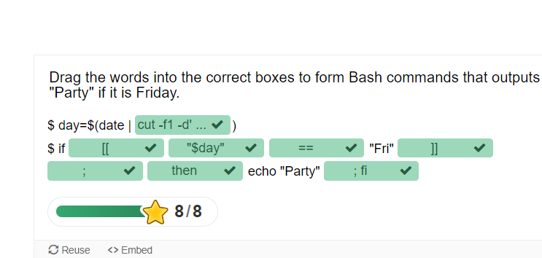
Week7 Handout Activities

Slide 4
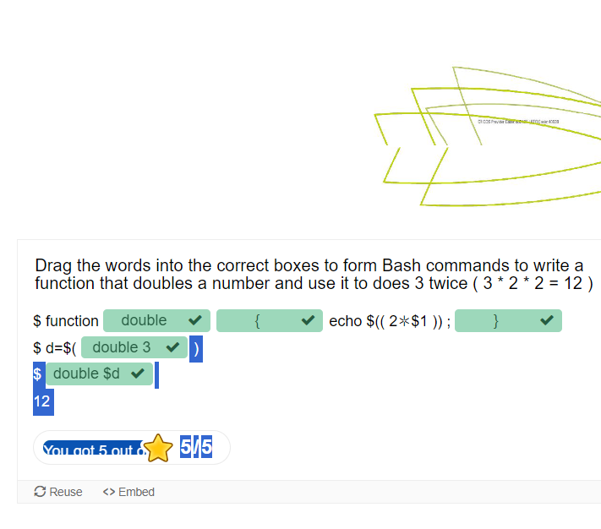
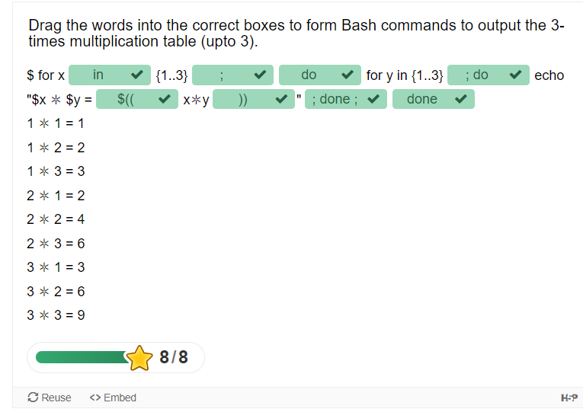
Week7 Handout Activities (Cont.)

Slide 5
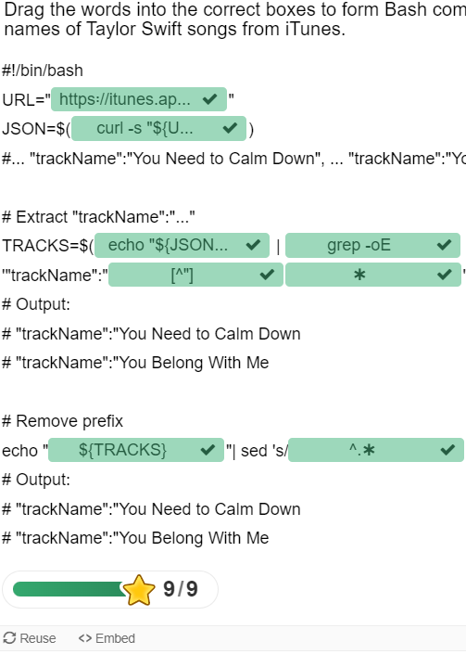
Week7 Handout Activities (Cont.)

Slide 6
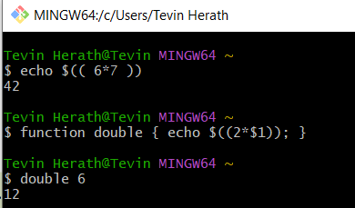
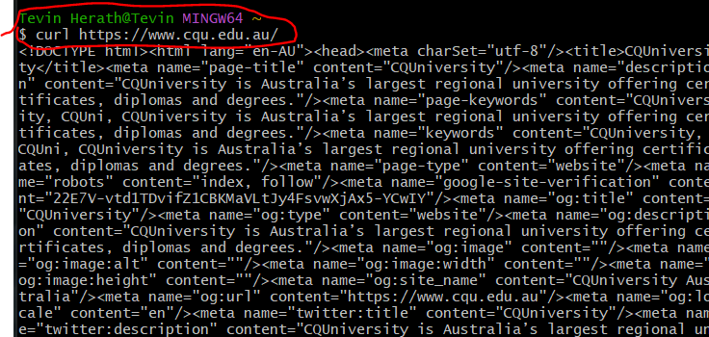
Linux Commands – Self Practice

Slide 7
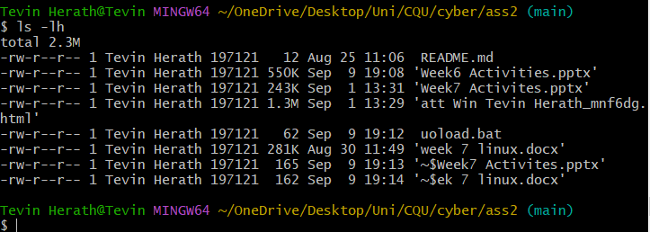
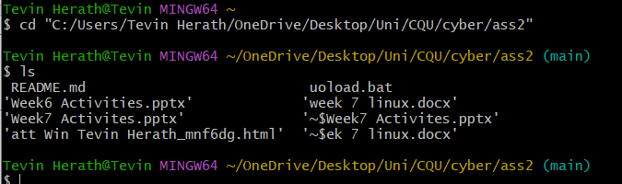
Linux Commands – Self Practice (Cont.)

